Slide 1
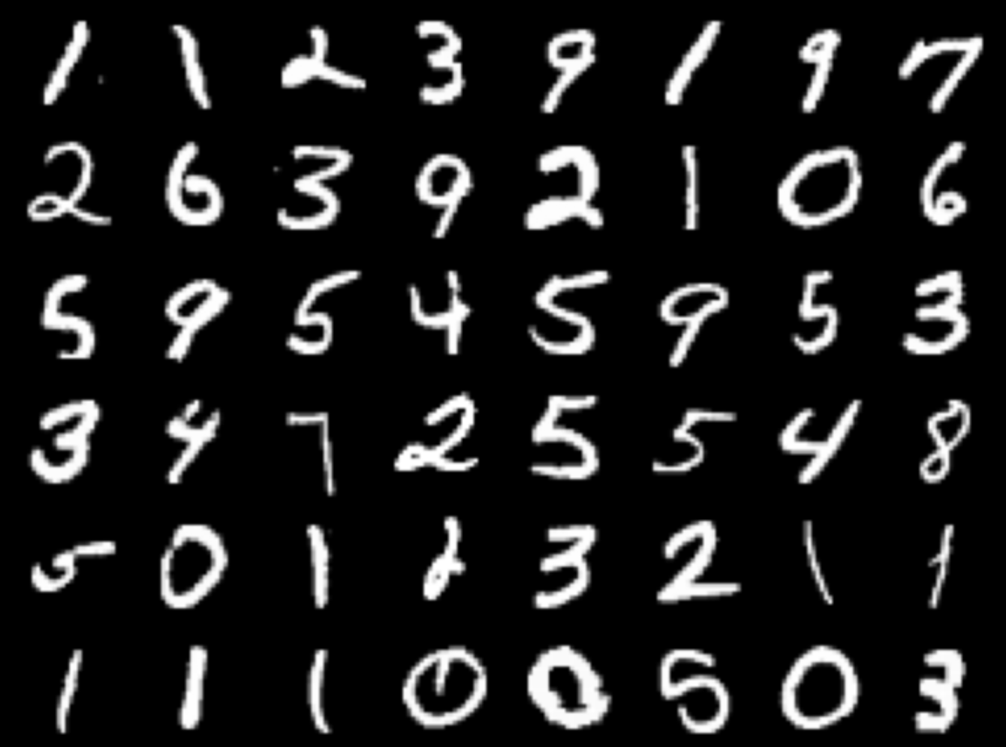
Handwritten Digit Recognition with Neural Network
By Gaganpreet Kaur
Professor: Xinlian Liu
Date: 12/8/2021
Computer Science Department
Hood College of Frederick Maryland

Slide 2
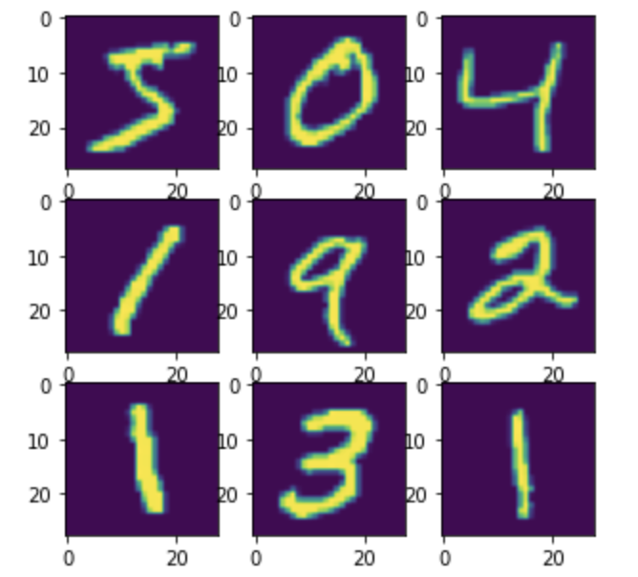
Project Overview
MNIST Dataset - De facto Standard
Recognize Handwritten Images
Train Dataset - 60K images
Test Dataset - 10K images
Benchmark for ML Algorithms
Use of CNN

Slide 3
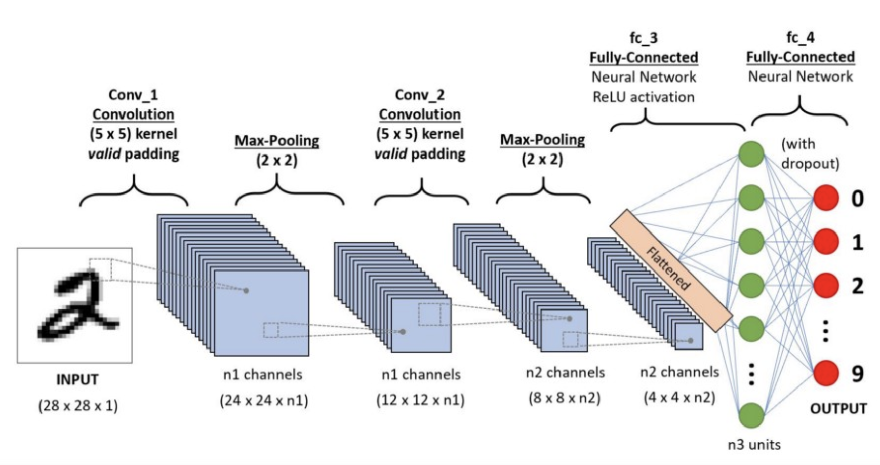
CNN Overview

Slide 4
Implementation Process
1. Load and Split Test and Train Images
2. Preprocess Test and Train images
3. Setup Neural Network
4. Network Compilation
5. Training the network with fit method
6. Evaluating the network’s performance

Slide 5
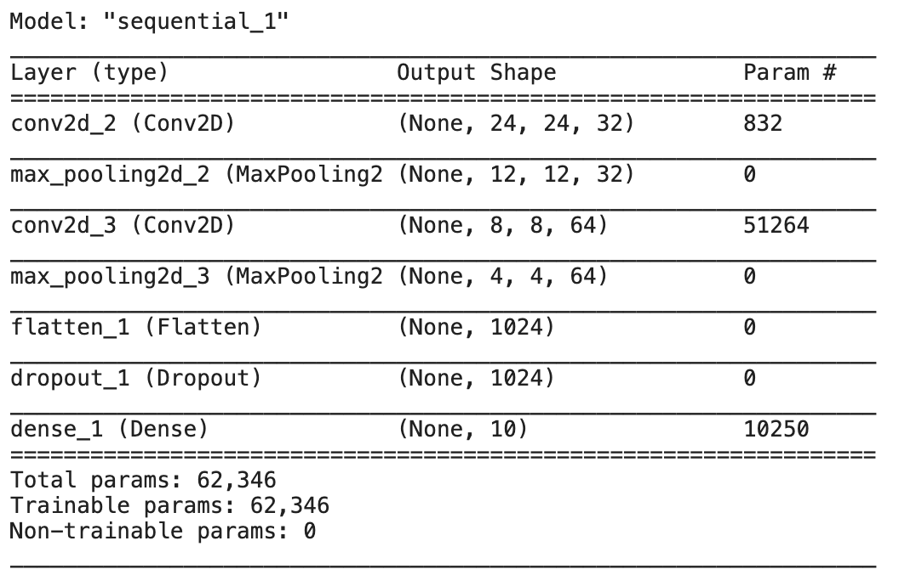
Model Summary

Slide 6
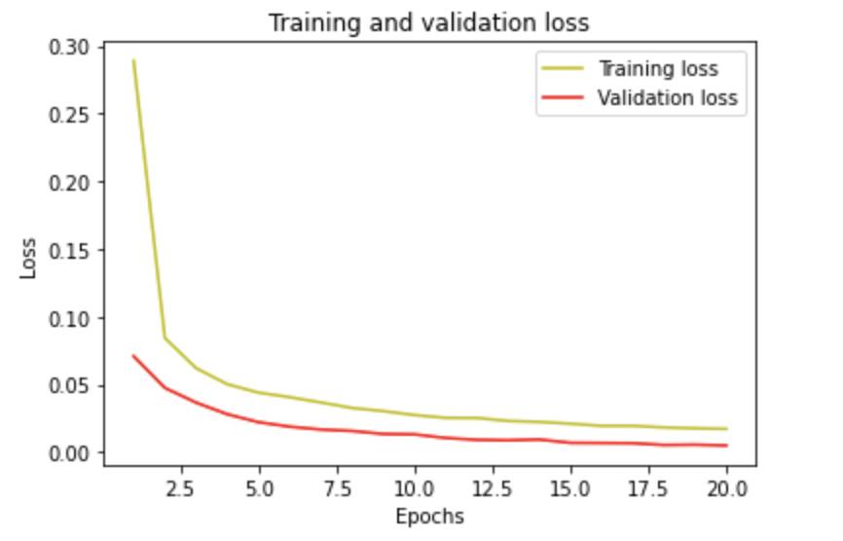
Results
Test Accuracy: 99.45%
Test loss: .017
Epoch: 20
Batch Size: 128

Slide 7
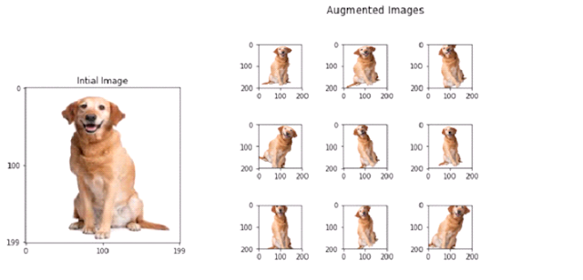
Achieving Better Performance
Leverage Larger Train dataset
Tune Parameters
Use Data Augmentation
Managing Overfitting and Underfitting

Slide 8
Other Methods
Deep Convolutional Generative Adversarial Network
Deep Neural Network
K-Nearest Neighbors
Random Multimodal Deep Learning
CNN with different classifiers

Slide 9
References
Deep convolutional generative Adversarial Network: Tensorflow Core. Retrieved December 9, 2021, from https://www.tensorflow.org/tutorials/generative/dcgan
Convolution Neural Network with 99.5 accuracy: Kaggle. Retrieved December 9, 2021, from https://www.kaggle.com/goelyash/convolution-neural-network-with-99-4-accuracy
Digit Recognizer: Kaggle. Retrieved December 9, 2021, from https://www.kaggle.com/c/digit-recognizer/overview
Convolution Neural Networks CNN. Retrieved December 9, 2021, from https://www.analyticsvidhya.com/blog/2021/05/convolutional-neural-networks-cnn/

